Slide 1
Time Series Analysis - Part 2
murthi

Slide 2
Distributed Lag Models
Modeling lags of X variables
S_{t} = a₀ + a₁ A_{t} + a₂ A_{t-1} + a₃ A_{t-2} + ε_{t}
Example: Advertising effects last for along period of time.

Slide 3
9.2
Finite Distributed Lags
Okun’s Law: Change in unemployment is related to growth in GDP
We can write it as:
DU = difference in unemployment levels
We can calculate the growth in output, G, as:
Eq. 9.10
Eq. 9.11

Slide 4
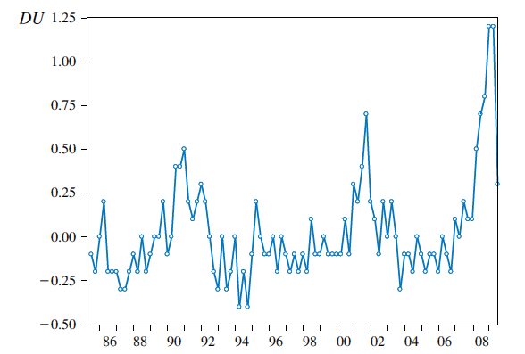
9.2
Finite Distributed Lags
Change in the U.S. unemployment rate
1985Q3 to 2009Q3
9.2.2
An Example: Okun’s Law

Slide 5
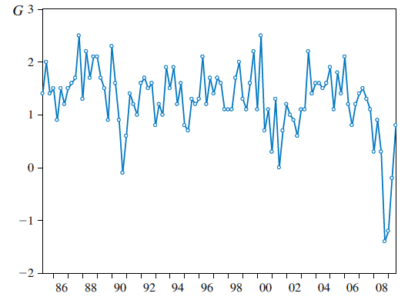
9.2
Finite Distributed Lags
U.S. GDP growth: 1985Q2 to 2009Q3
9.2.2
An Example: Okun’s Law

Slide 6
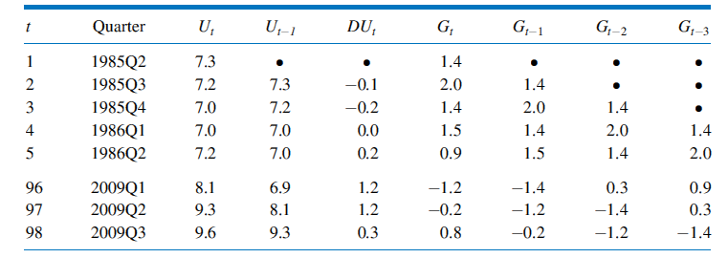
9.2
Finite Distributed Lags
Spreadsheet of Observations for Distributed Lag Model
9.2.2
An Example: Okun’s Law

Slide 7
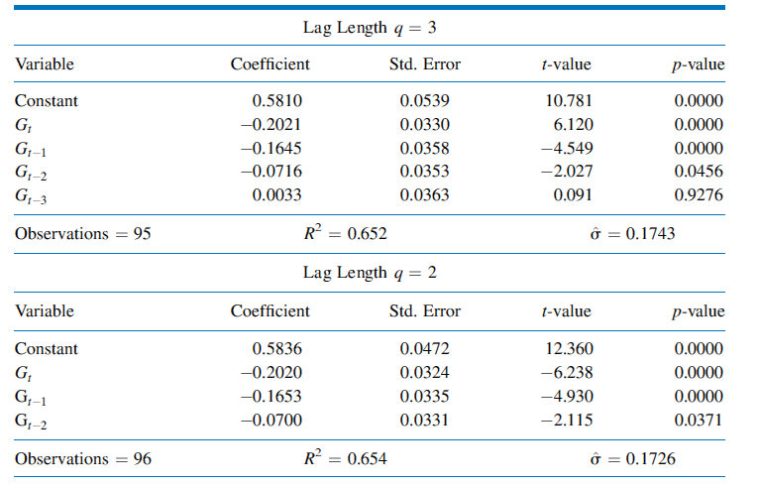
9.2
Finite Distributed Lags
Estimates for Okun’s Law Finite Distributed Lag Model
9.2.2
An Example: Okun’s Law

Slide 8
Stationary process
Is the underlying process invariant with respect to time?
Yes – then the time series is said to be stationary
Otherwise it is non-stationary.
In a stationary process the mean, variance and covariance are all stationary
If a series is non-stationary, it can be made stationary by first differencing.
i.e. compute y_{t} – y_{t-1}. Check if this variable is stationary.

Slide 9
9.1
Introduction
Stationarity
A stationary variable is one that is not explosive, nor trending, and nor wandering aimlessly without returning to its mean (i.e. not a random walk)
Mean(Y_{t}) = Mean(Y_{t+m})
Var(Y_{t}) = Var(Y_{t+m})
Cov(Y_{t}, Y_{t+k}) = Cov(Y_{t+m}, Y_{t+k+m})
for any value of m

Slide 10
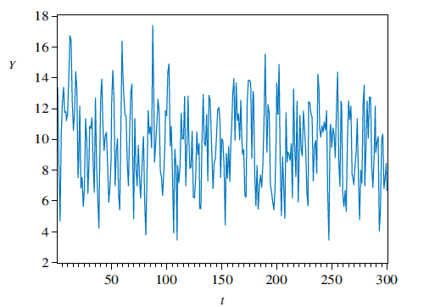
9.1
Introduction
Time series of a stationary variable
9.1.2a
Stationarity

Slide 11
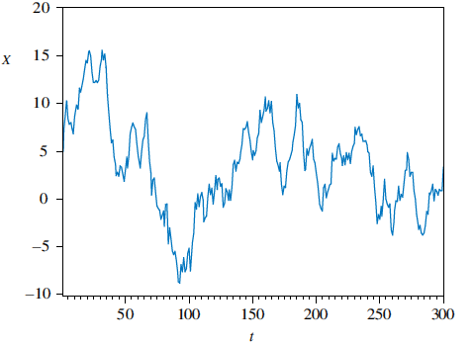
Time series of a nonstationary variable that is ‘‘slow-turning’’ or ‘‘wandering’’
9.1
Introduction
9.1.2a
Stationarity

Slide 12
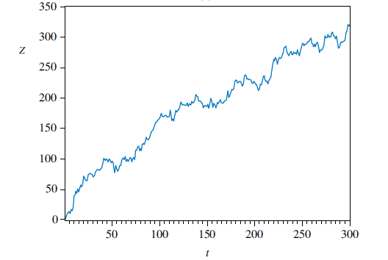
Time series of a nonstationary variable: Trend
9.1.2a
Stationarity

Slide 13
Random walk Model
Y_{t} = Y_{t-1} + ε_{t} E(ε_{t}) = 0, E(ε_{t,} ε_{s}) = 0
Generated for example by flips of a coin.
If heads, value = 1, if tails, value = -1
Forecast: Y_{t+1} = Y_{t}
Y_{t+2} = Y_{t}
But the standard error of the forecast increases over time
If we know a series follows a random walk model,
then there is no point in fitting a model.

Slide 14
Checking for Random walk
Y_{t} = a + bt + ρY_{t-1} + ε_{t} E(ε_{t}) = 0, E(ε_{t,} ε_{s}) = 0
Y_{t} - Y_{t-1} = a + bt + (ρ-1)Y_{t-1} + ε_{t}
If ρ=1, then series is random walk and non-stationary
Dickey Fuller tests (DF) – unit root tests
Augmented Dickey Fuller tests (ADF)

Slide 15
Regression one random walk against another will
give spurious results.
If a series follows random walk, differencing
might remove that.

Slide 16
Checking for white noise
Bartlett’s test: to test ρ_{k} =0
Sample autocorrelation coefficients are
approximately N(0,1/sqrt(T))
Q-test : joint test that all ρ_{k} =0

Slide 17
9.3
Serial Correlation
Computing Autocorrelation
Recall that the population correlation between two variables x and y is given by:
For autoregressive terms
ρ_{k} = cov(G_{t}, G_{t-k})/ var (G_{t})

Slide 18
9.3
Serial Correlation
9.3.1a
Computing Autocorrelation
Applying this to our problem, we get for the first four autocorrelations:
Eq. 9.16

Slide 19
9.3
Serial Correlation
9.3.1a
Computing Autocorrelation
How do we test whether an autocorrelation is significantly different from zero?
The null hypothesis is H₀: ρ_{k} = 0
A suitable test statistic is:
Eq. 9.17

Slide 20
9.3
Serial Correlation
9.3.1a
Computing Autocorrelation
For our problem, we have:
We conclude that G, the quarterly growth rate in U.S. GDP, exhibits significant serial correlation at lags one and two

Slide 21
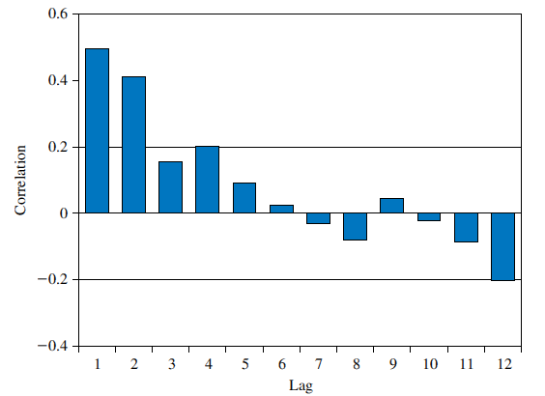
9.3
Serial Correlation
FIGURE 9.6 Correlogram for G
9.3.1b
The Correlagram

Slide 22
Lagrange Multiplier test
If e_{t} and e_{t-1} are correlated, then one way to model the relationship between them is to write:
We can substitute this into a simple regression equation:

Slide 23
9.4
Other Tests for Serially Correlated Errors
9.4.1
A Lagrange Multiplier Test
To derive the relevant auxiliary regression for the autocorrelation LM test, we write the test equation as:
But since we know that , we get:
Eq. 9.25

Slide 24
9.4
Other Tests for Serially Correlated Errors
9.4.1
A Lagrange Multiplier Test
Rearranging, we get:
If H₀: ρ = 0 is true, then LM = T x R² has an approximate χ²₍₁₎ distribution
T and R² are the sample size and goodness-of-fit statistic, respectively, from least squares estimation of Eq. 9.26
Eq. 9.26

Slide 25
9A
The Durbin-Watson Test
Durbin Watson test
We can now write:
If the estimated value of ρ is r₁ = 0, then the Durbin-Watson statistic d ≈ 2
This is taken as an indication that the model errors are not autocorrelated
If the estimate of ρ happened to be r₁ = 1 then d ≈ 0
A low value for the Durbin-Watson statistic implies that the model errors are correlated, and ρ > 0
Eq. 9A.3

Slide 26
Stochastic time series models
Autoregressive model AR(3)
S_{t} = a₀ + a₁ S_{t-1} + a₂ S_{t-2} + a₃ S_{t-3} + ε_{t}
Moving average model MA(3)
S_{t} = a₀ + a₁ ε _{t-1} + a₂ ε _{t-2} + a₃ ε _{t-3} + ε_{t}
A model with both components is called a ARMA(1,1) model.
S_{t} = a₀ + a₁ S_{t-1} + a₂ ε _{t-1} + ε_{t}

Slide 27
First de-trend and de-seasonalize the Y_{t} variable
Y_{t} - Y_{t-12} = a + b t + ε_{t}
Check if Y_{t} follows a random walk.
Look at ACF plots: if ACF drops to zero after q lags, then it indicates a MA(q) model.
Look at PACF plots: if PACF drops to zero after p lags, then it indicates a AR(p) model.
If both ACF and PACF do not become zero, it indicates ARMA (p,q) model
If ACF and PACF are zero at all t periods, it indicates a white noise process.

